Slide 1
Databases and Big Data

Slide 2
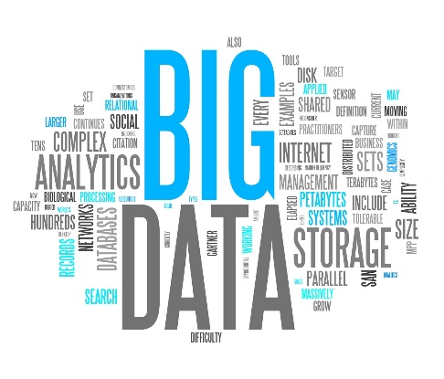
What is Big Data?
Big data is extremely large, complex data sets, mainly from new data sources. Typically these data sets are too large to be processed in the normal fashion, as typical data processing software would not be able to handle the large volume of information. Some examples of big data would be; sensor information, photographs, text, voice and video data. These could come from a variety of places such as social media or even internet connected smart devices. There are 3 key characteristics that define big data, also known as the 3 V’s…

Slide 3
Volume
This is the amount of data. When dealing with big data high volumes of unstructured, low density data has to be processed. Some organisations can have up to terabytes or even petabytes of data to process. Extreme amount of data is generated each second from cell phones, social media, cell phones, cars, credits cards, sensors, photographs, video, etc. The amount of data has become so large that we can no longer use traditional database technology to analyse it, currently a distributed system is used in which the data is stored in many different places and locations and then brought all back together in one place using some software.

Slide 4
Velocity
Velocity is a measure of how fast the data is created, received , stored and analysed. In the past when batch processing was the standard procedure, it was fairly common to only receive and update from the data base every night or even every few days. Sevres required a sizeable amount of time to process and update their databases. However; when using big data, the data is created in real-time. With internet-connected devices, wired or wireless, machines and devices can pass on the data the exact moment it is created.
Currently the speed at which data is being created is extremely substantial: Every minute we send over 200 million emails, view 20 million photos, upload 100 hours of videos on YouTube and 2.5 million searches are carried out on google. Organisations have a huge challenge when it comes to this as all this data is used and created in real-time.

Slide 5
Variety
Variety is the many different types of data we are able to use, big data is no longer just structured , the majority of it (around 80%) is now unstructured data. However; now new technology is being created to allow structured and unstructured data to both be used and stored simultaneously.

Slide 6
Big data used in databases
Big data used in database for businesses will allow them to collect and analyse their products, resources and their customers. So big data would improve and be a cheaper alternative for other applications as big data are open source where large amounts of data can be stored and to identify specific information.
Big data can reduce time as it can identify new sources of data that can help a business analyse thoroughly and would not be time consuming to make a decision as there is a good amount data that can be used a reliable source. Also big data from a database can be used to see customer trends and needs so it can help the business to produce ideas around their findings which can attract them as it would be targeting their satisfaction.

